Slide 1
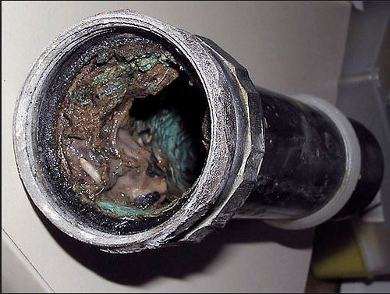
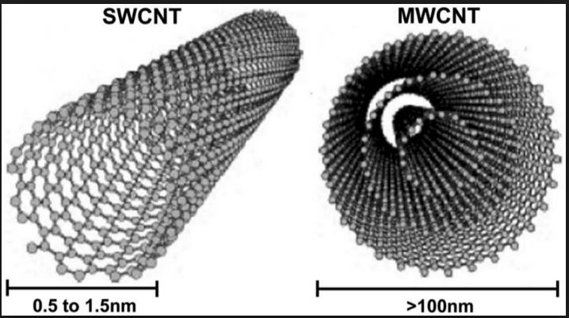
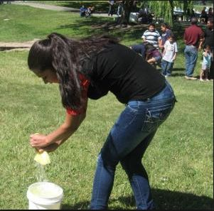
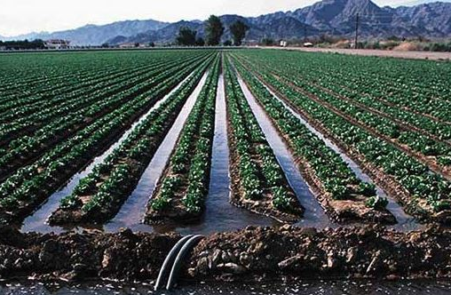
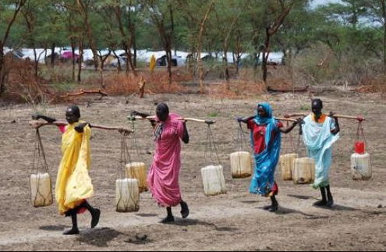
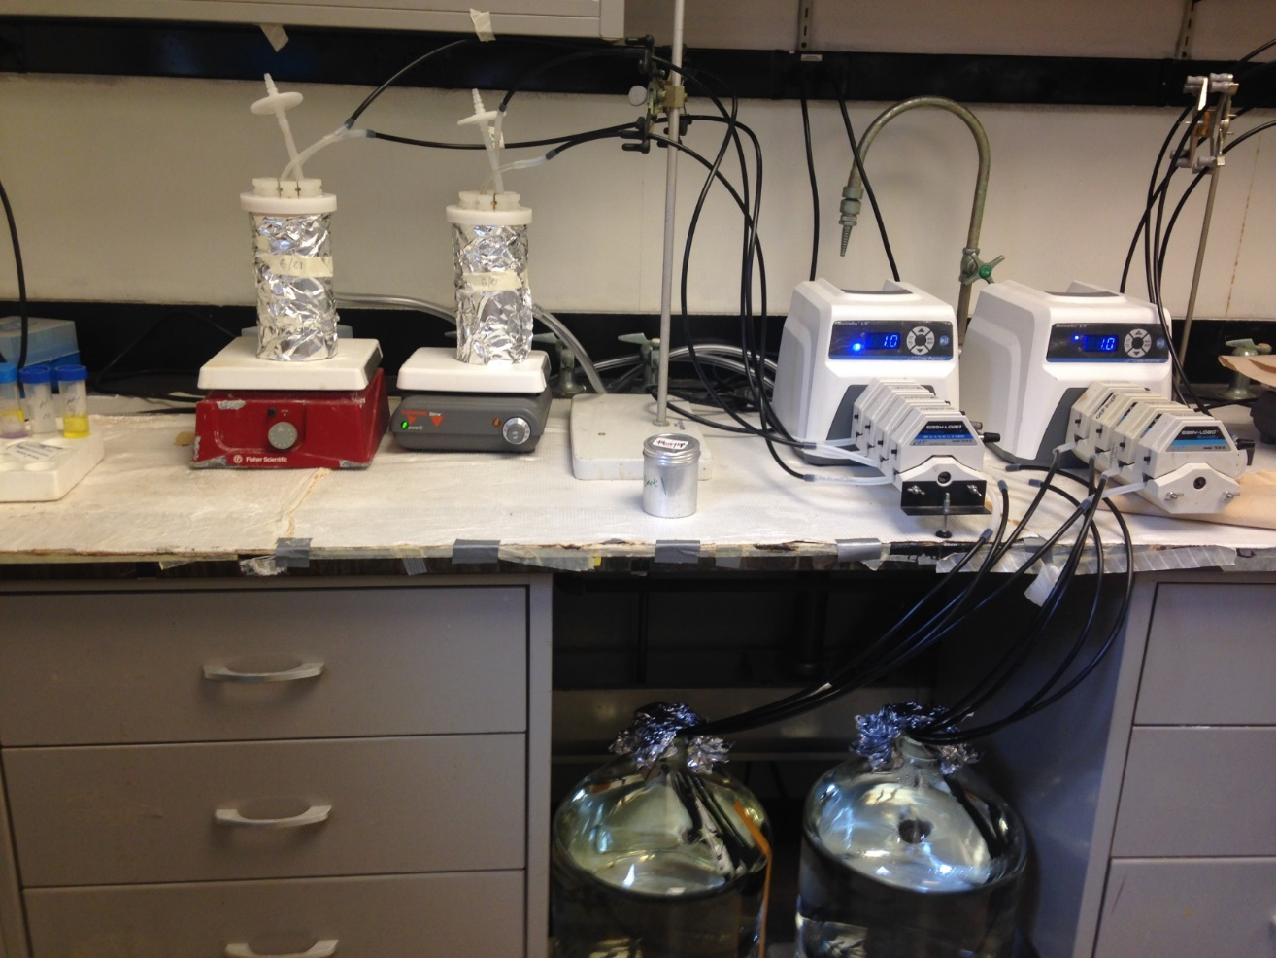
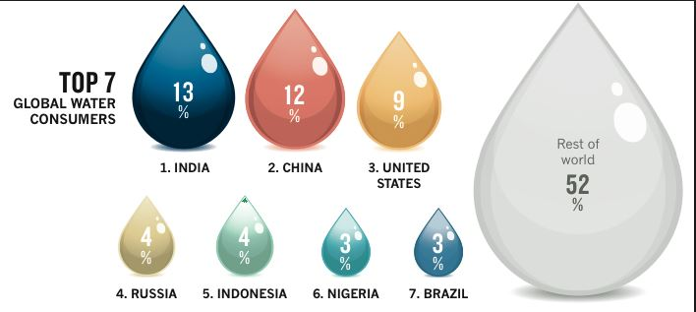
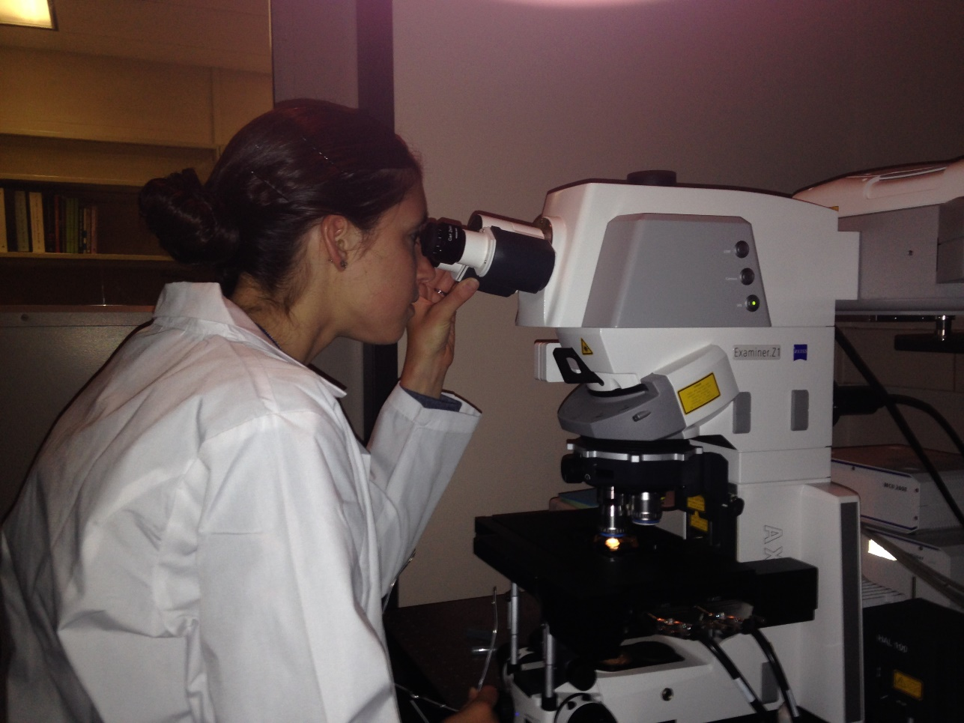
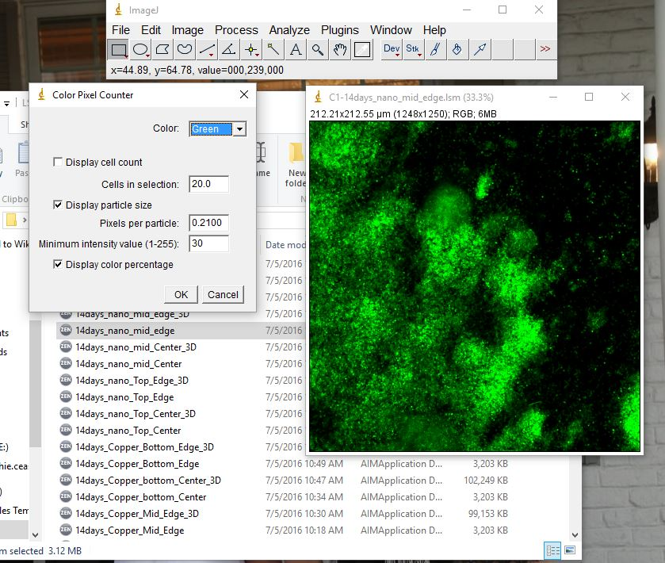
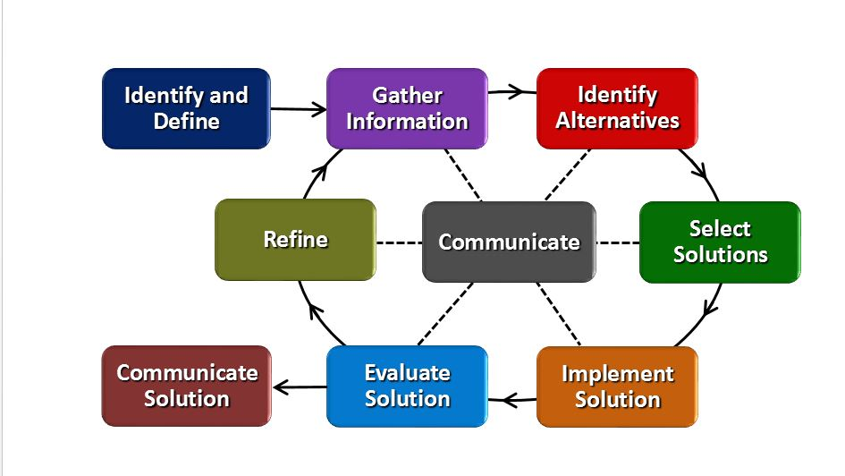
How Does Your Garden Grow? Amy Parker Finneytown High School, Environmental Science, 11-12
RET is funded by the National Science Foundation, grant # EEC-1404766
Exactly WHAT is in
Your Drinking Water?
How Can We Apply This?
Why is Water Transportation
Important to Me?
The Hook
www.biofilm.montana.edu
jdr.sagepub.com
warpedboards.wordpress.com
Research Focus: Nanocomposites = new pipe material
www.seametrics.com
www.dansations.com
www.civileblog.com
blogs.oxfam.org
Biofilm in the water distribution system. Public health risk?
What do a few buckets of water, random size cups, and energetic students have to do with water transportation..?
Big Idea: Water Transportation
Challenge Based Learning
Biofilm reactors built to test nanocomposites vs. copper
Big Idea
Essential “?”
Challenge
Guiding “?”
Engineering Design Process
web.mit.edu
Unit Implementation Timeline
Complete Unit: 12 Days
Lesson 1: 5 Days Lesson 2: 7 Days
Activity 1: 2 Days Activity 3: 2 Days
Activity 2: 3 Days Activity 4: 5 Days
Laser Scanning Microscope for biofilm imaging
ImageJ Software was used to analyze biofilm growth

